Slide 1
Annual Report 2023
Positive Pathways continued to work on recovering and growing post-COVID pandemic. The PRIDE Program has been growing throughout the year as court related functions and enforcement have returned to normal. Also related to individuals involved in the judicial system, Positive Pathways’ was awarded a contract to provide re-entry services for inmates being released from State correctional facilities. This expansion will allow Positive Pathways to help many more individuals in the coming years. Relating to the community… For the fifth consecutive year, Positive Pathways participated and was a sponsor at the Pittsburgh Recovery Walk. Positive Pathways’ staff host a booth/table with recovery resources and carry a “recovery banner” in the Walk. Positive Pathways has also continued to participate in community overdose prevention events and will participate throughout 2024. The aim of which is to bring awareness to treatment options available in the community. The following are specific updates regarding PRIDE Program, Equine Program, Women’s Group, DOC
Contract and the Recovery Walk:

Slide 2
PRIDE Program:
The Program for the Re-Integration, Development and Empowerment (PRIDE) is the treatment component for Allegheny County Prostitution Court, which is a diversionary, specialty court for the Allegheny County Court of Common Pleas, presided over by the Honorable Kevin G. Sasinoski. The PRIDE Program works with individuals who have been convicted of a prostitution offense. PRIDE addresses recovery from the lifestyle of prostitution and exploitation from a post-traumatic stress model focusing specifically on the complex issues resulting from involvement in the sex industry. During 2023, prior protocols continued to solidify and by the end of the year were standardized. Also in 2023, the Program began accepting female clients with extensive trauma histories that could benefit from Pride services even though the criminal charges may not be specifically related to prostitution. A successful expansion to help more of those in need was accomplished and championed by Johnna Z. and Judge Sasinoski.

Slide 3
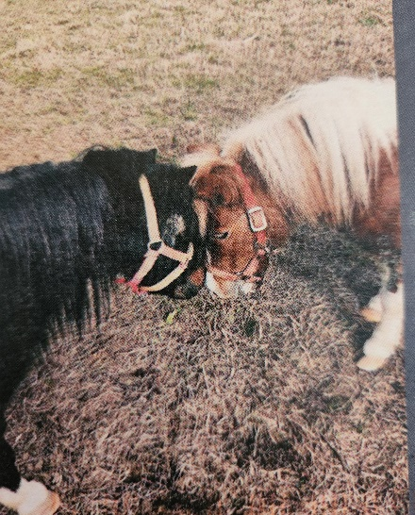
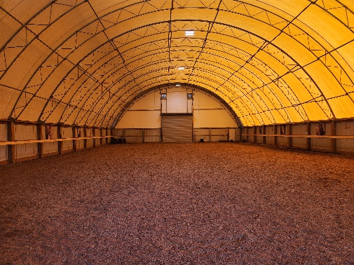
Equine Program:
Positive Pathways’ Equine Program continued to create excellent results in 2023 and as a result there is planned commitment in 2024. Positive Pathways participated in a weekend training at The Ranch in the Fall of 2023. Training and exercises were conducted with our mini-horses, Hannah and Sven, in their new indoor arena (see below).
For those new to the Equine program, the program is designed to connect clients with rescued horses to help discover a path to healing from trauma and other emotional pain. The horses that participate with Positive Pathways’ clients are all rescues boarded at the Pleasant Valley Rescue Ranch in Murrysville, PA. The horses have experienced trauma and abuse and were rescued from their situations. They have been rehabilitated and extensively trained to share in this healing journey. Positive Pathways’ program was originally designed as a four session program and subsequently increased to eight sessions in order to expand the patients’ unique treatment experience and the opportunity to interact with these amazing animals.

Slide 4
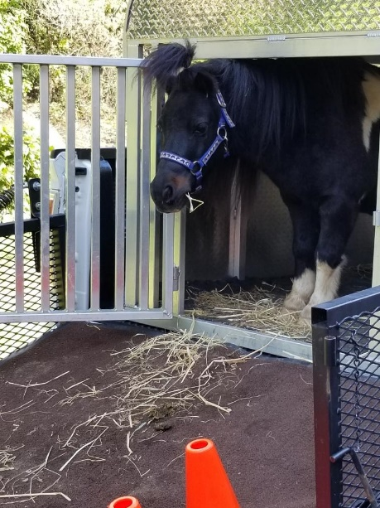
The curriculum for the Equine Program focuses on building skills for safety and respect while learning how to work with the horses. Patients will gradually, over several sessions, have personal interaction with the animals to begin building an awareness of the horses’ sounds and movements, focus on interactions around our five senses (trauma informed focus) and be able to build a mindful connection to them. Clients will discuss what he/she can learn from each sense and the observation of the animals and their communications with the client. Trainers will focus on tone control in our voices and how to build relationships through mutual respect without fear. Clients will have the opportunity to learn to bucket feed the animals and eventually build their relationships to the point of hand feeding. Trainers and clients will explore the deeper connection humans can have with animals through trust and bonding.

Slide 5
Women’s Group:
Women’s Group at Positive Pathways was created in 2019. Women’s Group offers a once a month, three-hour group that women can attend to discuss specific topics such as: parenting, relationships, self-image, self-worth, self-esteem, self-care, women’s health, women specific roles and how these issues connect to recovery. Creative expressive therapy and Cognitive Behavioral Therapy are utilized to teach women ways to cope, reduce stress, and balance life and recovery. Therapeutic techniques employed include music, meditation, art therapy, five senses activities, journaling and supportive discussion. The environment is assembled to allow women to freely speak about topics that may be uncomfortable within a co-ed group. The environment is established to empower women with support and connection. As with our other successful programs, continued commitment will occur in 2024.
Department of Corrections Contract:
2023 brought forth a great advancement at Positive Pathways in the ability to assist a wider population of clients (as also with the Pride Program). Dina C. and Johnna Z. spearheaded the effort to receive a Department of Corrections contract to provide Intensive Outpatient and Outpatient services to male and females re-entering society post-incarceration. Positive Pathways looks forward to partnering with the DOC in 2024.

Slide 6
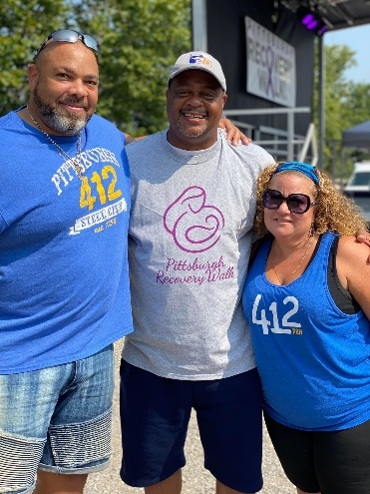
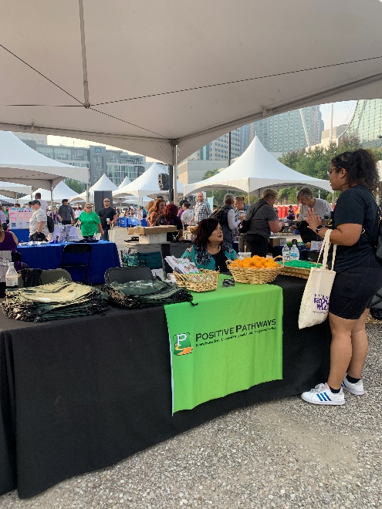
Recovery Walk (some pics)
Again, in 2023, Positive Pathways supported through sponsorship and participation, Pittsburgh’s Recovery Walk. This has been Positive Pathways’ fifth year in a row participating and plan to sponsor and participate in 2024. Here is Darryl and Dina with a great supporter of the Recovery Walk, Mayor Gainey. As well as Johnna, at our booth, discussing and providing recovery materials to a member of the community participating in the event.

Slide 7
Suboxone/MAT Counseling Available
Psychiatric Treatment Available
Individual Sessions
Group Sessions
Psychiatric Services
Three Convenient Locations (Sq. Hill, West End, Cranberry Twp.)
Thank you and please contact Positive Pathways for quality treatment options. Have a great day!
Phone: 412-224-2812
www.positivepathwayspa.com

